Slide 1
Diet Manager
Project
Group G1
Lehady Sani-Agatha, Matija Selak, Ivan Susnjara, Leon Grubisic, Boris Fjorovic

Slide 2
OUTLINE
Overview
Overview of the System (UML Class Diagram)
Issues We Came Across
Our Solution
What Could Have Been Improved

Slide 3
Overview
This application will be used to keep track and calculate the food intake by the user. We divided our application into several modules and add an abstract layer at the top of each module. Such as food interface that holds methods which are used in both basicFood and recipe class. For this project, we will depend on the abstraction layer. To make our application open for future extensions. We will hold duplicate functionalities in our composite pattern to make it accessible through the whole application. This will make our modification a lot easier. We will give each class, method, and module a single responsibility for each of them in order to minimize regressions. Each module knows what another module does, but it will not know its functionalities.

Slide 4
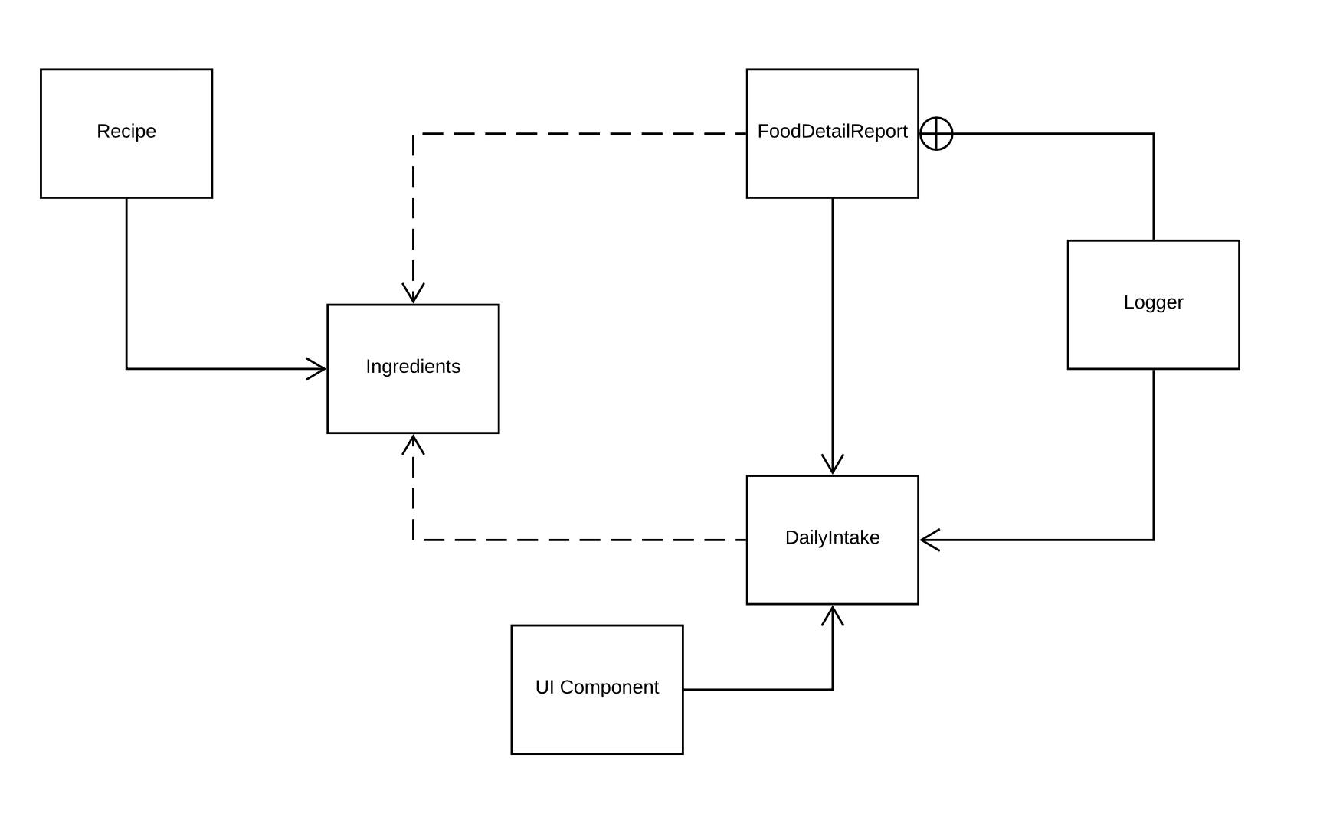
Overview of the System - First UML

Slide 5
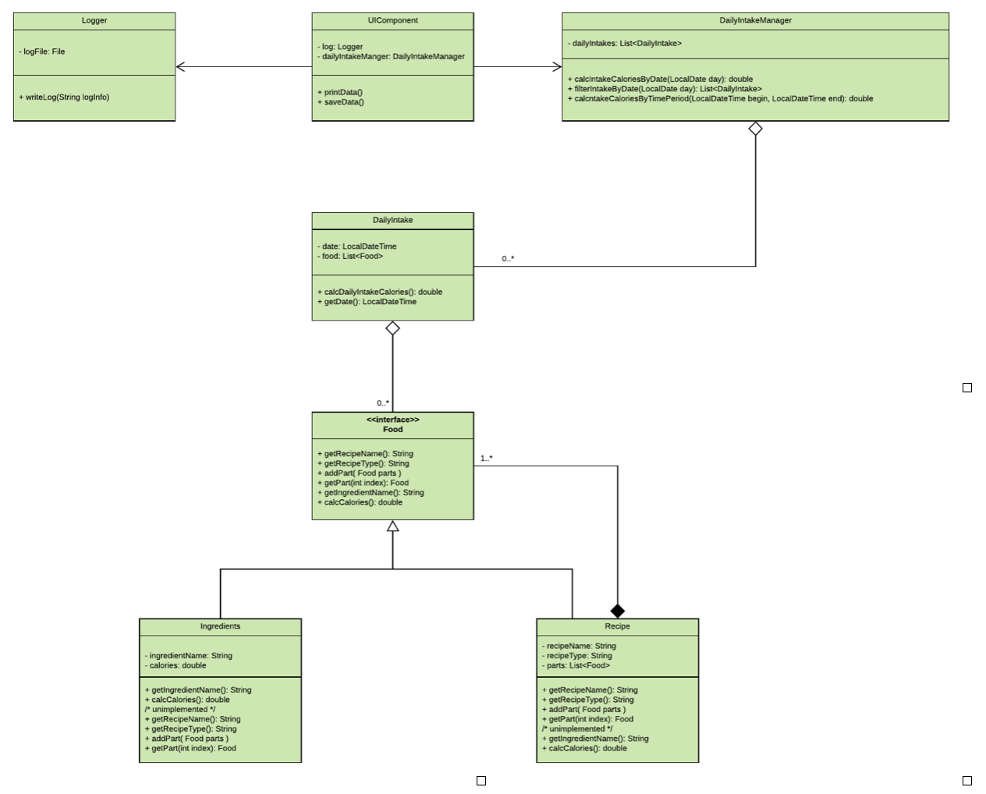
Overview of the System - Second UML

Slide 6
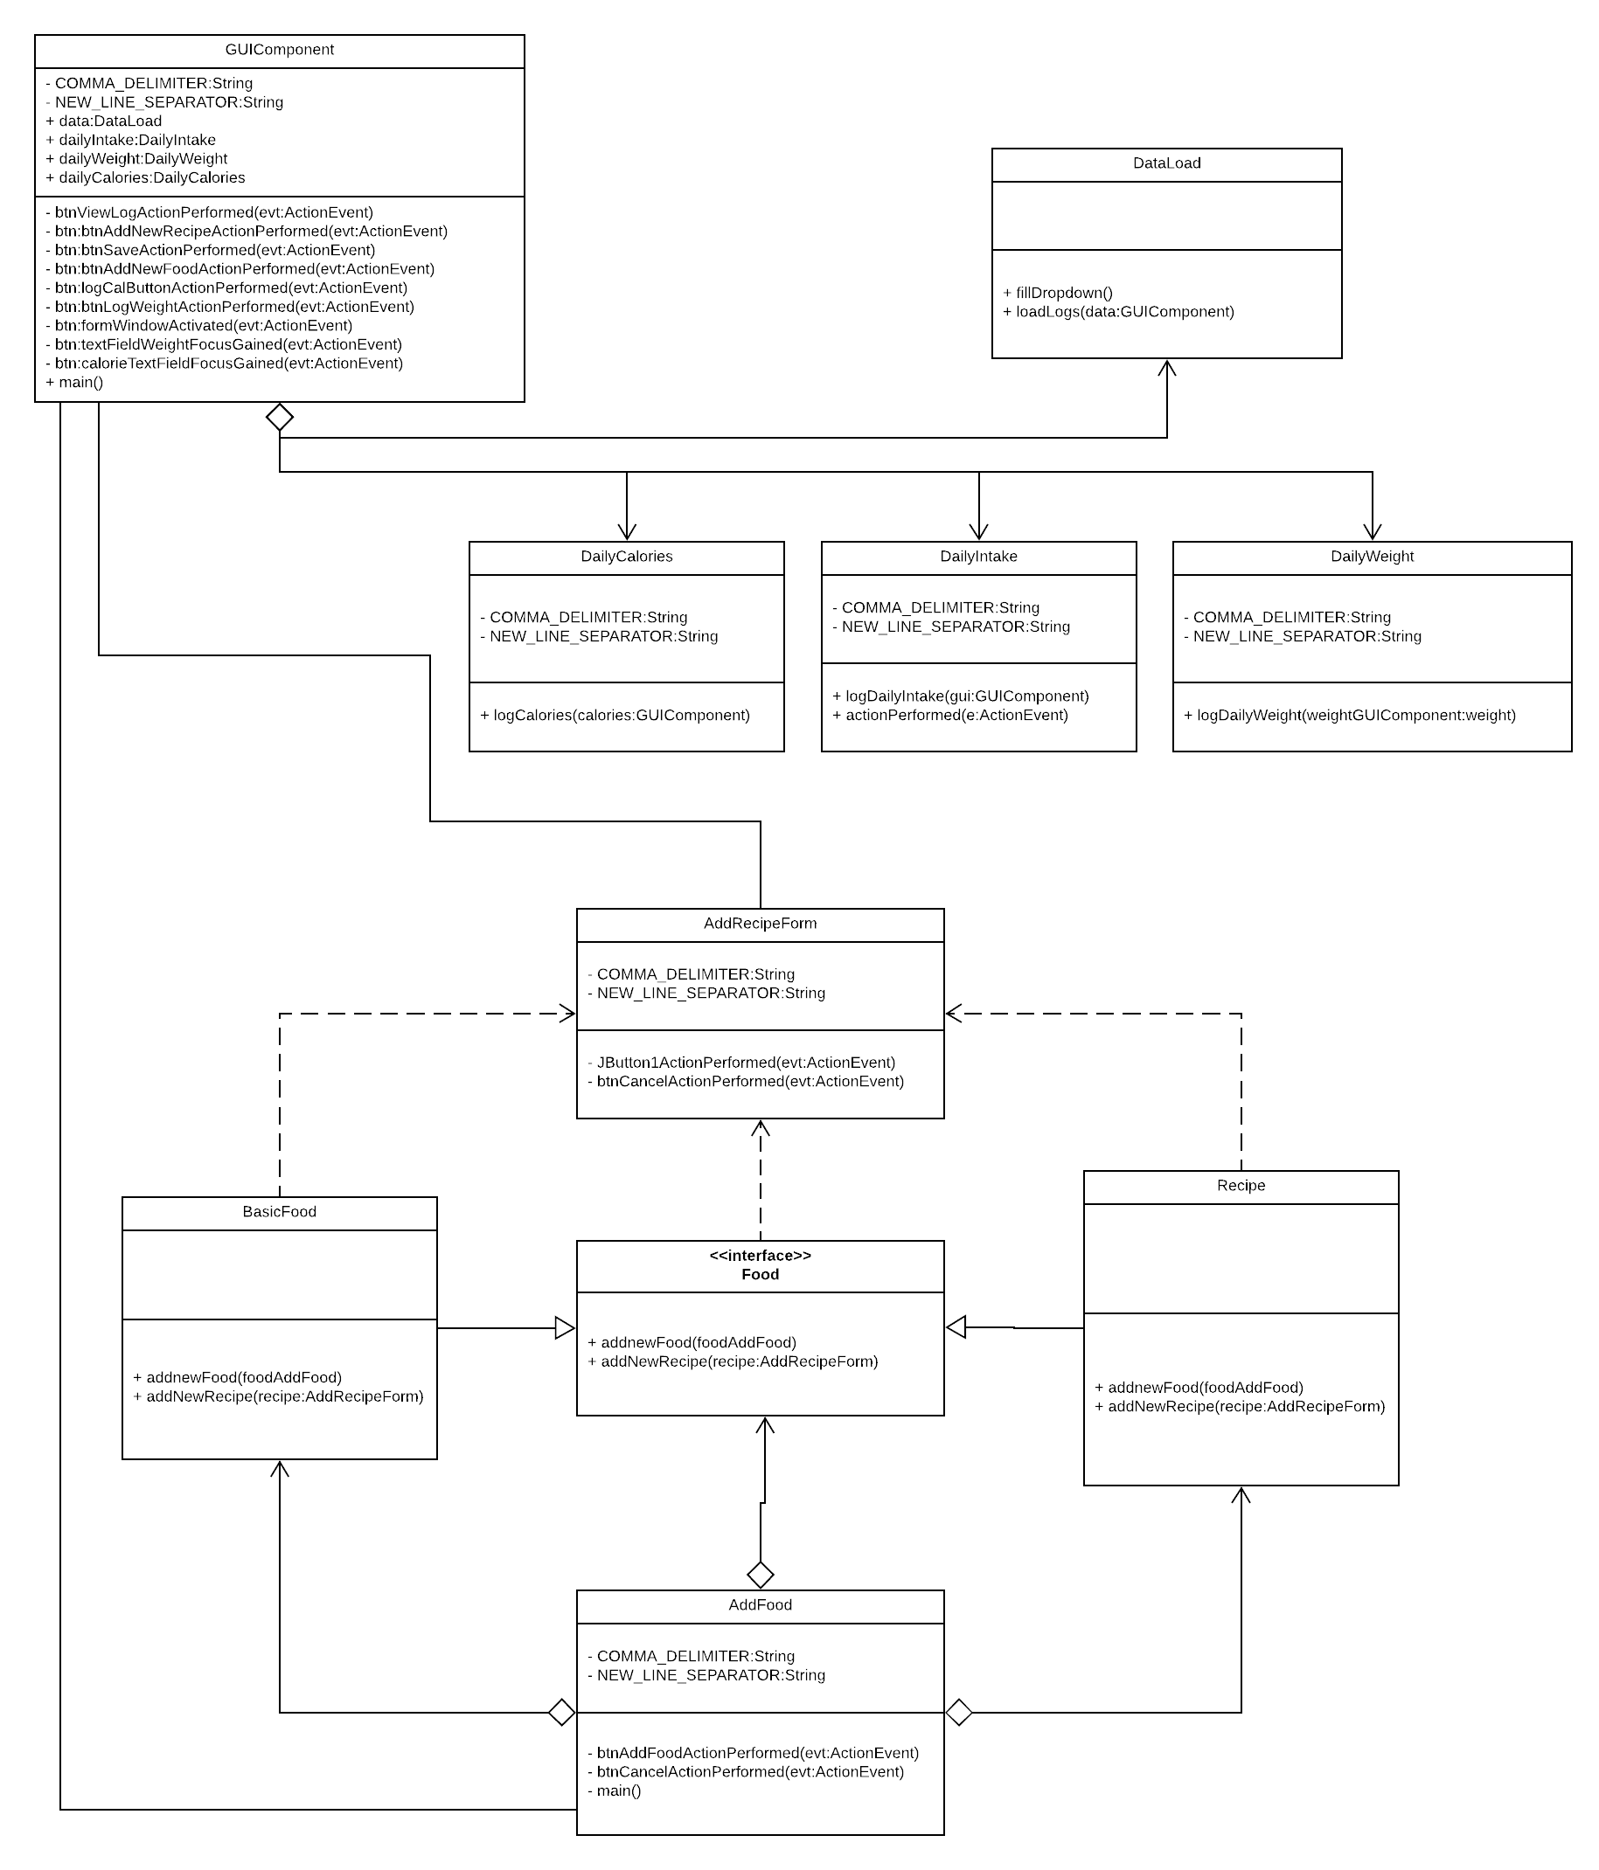
Overview of the System - Third UML

Slide 7
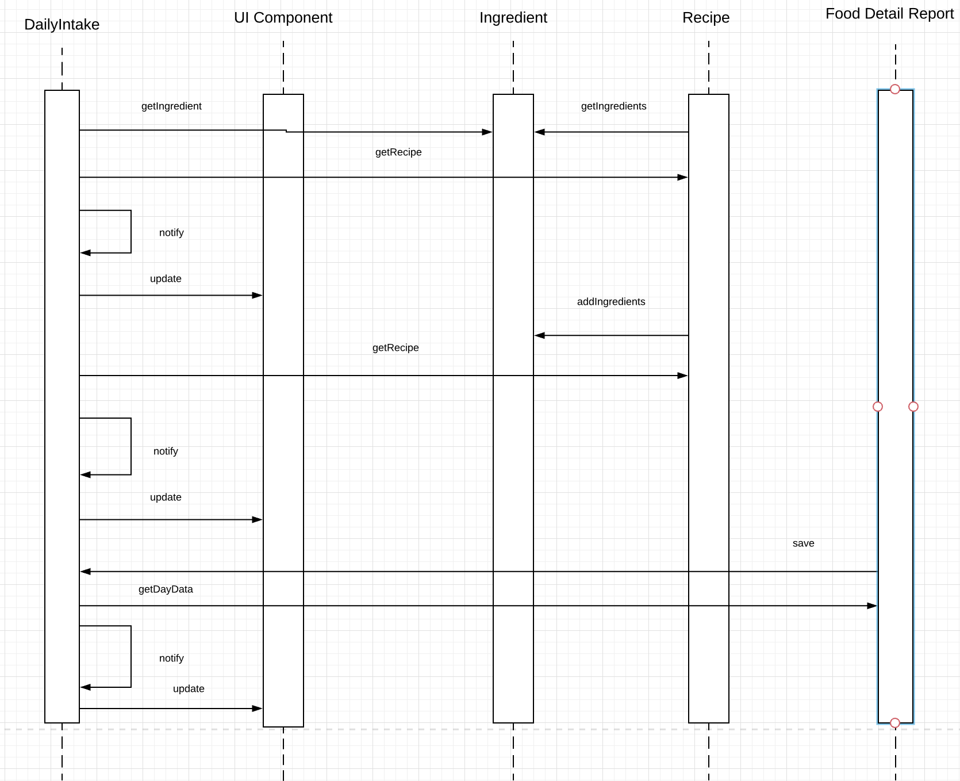
Overview of the System-First Sequence diagram

Slide 8
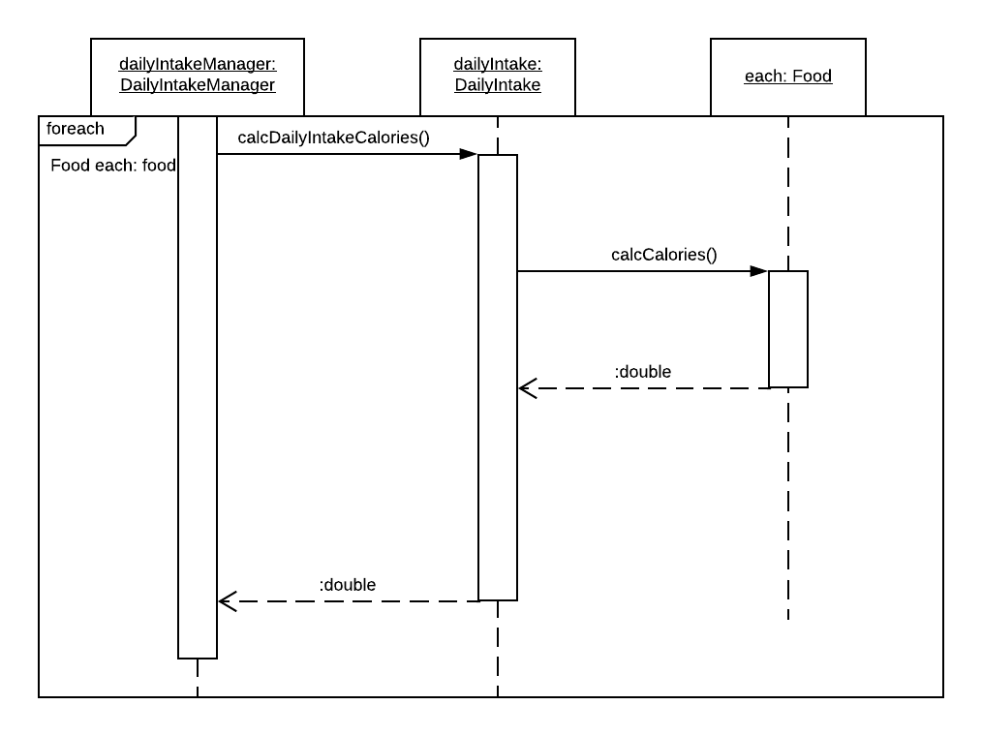
Overview of the System-Second Sequence diagram

Slide 9
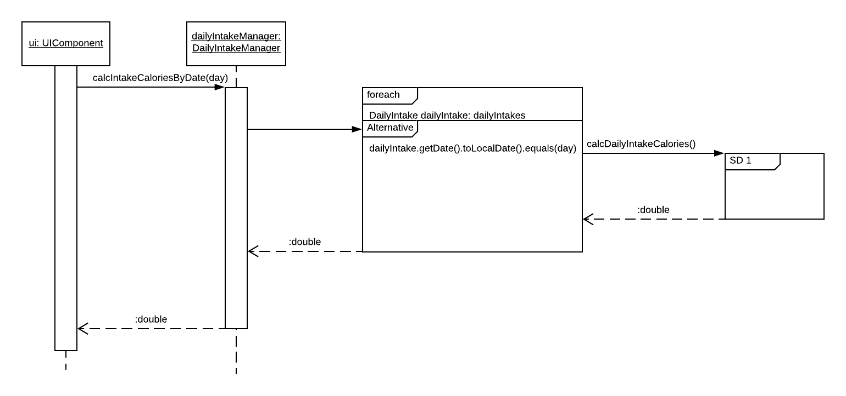
Overview of the System-Second Sequence diagram

Slide 10
Issues
The issue we ran into was adding calories, fats, carbs and proteins on a specific day and to put them into the percentage calculator
Another issue was filtering the log by date to present all of the data logically

Slide 11
Solutions
-- We solved the filtering by using the date picker and comparing the date with the log to get the fats, proteins, carbs and calories by date
-- Then we used mathematical formulas to calculate the percentage by date

Slide 12
Improvements
-- At this point of project our improvement would be
To fix GUI so it is more user friendly and that it looks nicer
To fix codesmell
To decrease the size of code
To decrease complexity

